Slide 1
DATA BOOTCAMP 2022
AWS Redshift concepts and Best Practices

Slide 2
DATA BOOTCAMP 2022/AWS Redshift concepts and Best Practices
Short overview
Create new schema
- Access and roles for the new schema
- Groups and roles
Create new table
- encoding styles
- sort key
- dist key
Create views
Best practices for designing tables
Interrogate data (window functions, stored procedures)
SQL tuning (concepts)
Importing/exporting data

Slide 3
DATA BOOTCAMP 2022/AWS Redshift concepts and Best Practices
Schema
When a schema is created a quota can be specified. The quota parameter is used to specify the maximum amount of disk space that the schema can use.
User and group access on a schema
When creating a schema in order to be used by a group of users we need to grant usage that group on the new schema
Notes:
Creating groups: https://docs.aws.amazon.com/redshift/latest/dg/r_CREATE_GROUP.html
Alter schema docs: https://docs.aws.amazon.com/redshift/latest/dg/r_ALTER_SCHEMA.html
Other alter commands can be found here: https://docs.aws.amazon.com/redshift/latest/dg/c_SQL_commands.html

Slide 4
DATA BOOTCAMP 2022/AWS Redshift concepts and Best Practices - Create/Alter tables
Create/Alter tables
Temporary vs permanent
Default
Identity
Compression
Constraints
Sorting
Distribution
Notes:
Documentation : https://docs.aws.amazon.com/redshift/latest/dg/r_CREATE_TABLE_NEW.html Default identity columns are NOT NULL. NULL can't be inserted.
Overriding values of a default identity column doesn't affect the next generated value.
You can't add a default identity column with the ALTER TABLE ADD COLUMN statement.
You can append a default identity column with the ALTER TABLE APPEND statement.

Slide 5
DATA BOOTCAMP 2022/AWS Redshift concepts and Best Practices
Use compression when creating a table
Compression is a column-level operation that reduces the size of data when it is stored. Compression conserves storage space and reduces the size of data that is read from storage, which reduces the amount of disk I/O and therefore improves query performance.
Encode AUTO is the default for tables.
There are multiple ways of compression:
RAW(no compression), AZ64, Byte dictionary(BYTEDICT), Delta, LZO, Mostlyn, Run-length, Text, Zstandard(ZSTD).
Notes:
More details on compression here:
https://docs.aws.amazon.com/redshift/latest/dg/c_Compression_encodings.html

Slide 6
DATA BOOTCAMP 2022/AWS Redshift concepts and Best Practices - Create/Alter tables
Define table constraints
Uniqueness, primary key, and foreign key constraints are informational only; they are not enforced by Amazon Redshift.
Define primary key and foreign key but take in consideration that these are only formal for the table, these are not enforced by RS(sample to add)
If we allow invalid foreign keys or primary keys, some queries could return incorrect results. For example, a SELECT DISTINCT query might return duplicate rows if the primary key is not unique.
Do not define key constraints for your tables if you doubt their validity. On the other hand, you should always declare primary and foreign keys and uniqueness constraints when you know that they are valid.

Slide 7
DATA BOOTCAMP 2022/AWS Redshift concepts and Best Practices - Redshift SORT KEYS
Redshift SORT KEYS
Why do we use sort keys?
Rows are stored on disk in sorted order based on the column you designate as a sort key
Like an index
Makes for fast range queries
Choosing a sort key
Recency? Filtering? Joins?
Single vs. Compound vs Interleaved sort keys

Slide 8
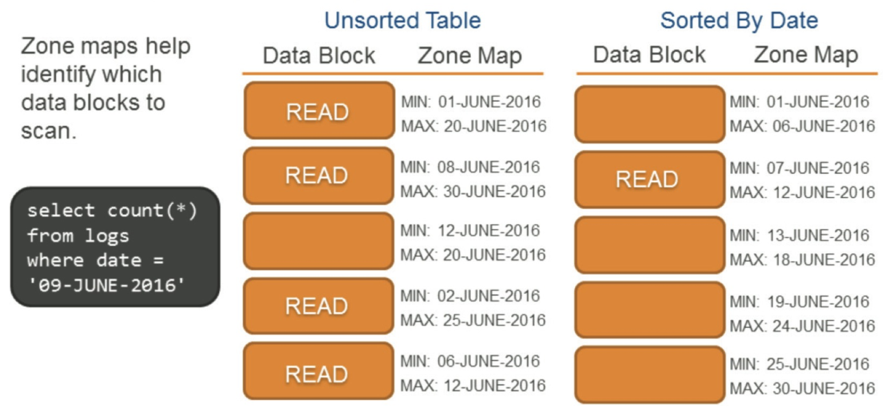
DATA BOOTCAMP 2022/AWS Redshift concepts and Best Practices - Redshift SORT KEYS
Sorting methods
Redshift uses sort keys to determine the order that data is stored on disk
If a table doesn’t have a sort key, the data is stored in the order that it was loaded into the table
Sorting, paired with zone maps, can help make query processing much more efficient by helping identify the data blocks that Redshift should scan. Use with predicates (ranges, such as a date range as shown in this example).
Notes:
A zone map:
● Is similar to an index.
● Is cached in memory.
● Holds the minimum and maximum value of a data block.
● Issued to exclude unnecessary data blocks when executing queries.

Slide 9
DATA BOOTCAMP 2022/AWS Redshift concepts and Best Practices - Redshift SORT KEYS
Different types of sort keys:
Single column sort key:
Consists of a single column in the table
Interleaved sort key:
Is very useful for queries on larger data sets (> 100 million rows)
Consist of up to 8 columns that are all given equal weight in queries so the order in which you list the columns does not matter.
If end users query different columns equally, then use an INTERLEAVED sort key
Notes:
More details related to the interleaved and compound sort key can be found here: https://dev.classmethod.jp/articles/redshift-sortkey-usecase-en/
Interleaved sort key is also made up of one or more of its columns, but each sort key column has equal importance . That is using only the secondary column can still work. Especially, when filtering with the WHERE clause, or when the sort key column has a long (more than 8 bytes) common prefix, interleaved sorting will give better performance than compound sorting.
To keep fully benefit of Interleaved sorting, you need to periodically execute VACUUM REINDEX to the tables. The total time of VACUUM REINDEX will be longer than that of VACUUM FULL because a VACUUM REINDEX operation requires an extra analysis of the distribution of the values in interleaved columns before performing a VACUUM FULL operation. If a VACUUM REINDEX operation can't be included in a daily batch operation, you shouldn't use an interleaved sort key on columns with monotonically increasing attributes, such as id, dates, or timestamps in order to prevent its distribution from getting larger.

Slide 10
DATA BOOTCAMP 2022/AWS Redshift concepts and Best Practices - Redshift SORT KEYS
Compound sort key:
Is useful when a sort key column is used in query predicates (WHERE clauses) or to make GROUP BY and ORDER BY more efficient
A compound sort key is most useful when a query scans rows according to the order of the sort columns; if you have a know pattern query the COMPOUND sort key is the best choice.
The performance benefits of sorting with a compound key decrease when queries rely on secondary sort columns.
You can define a maximum of 400 COMPOUND SORTKEY columns per table.
Notes:
Compound sort key is the default sort type in Redshift and made up of one or more of its columns. Basically, Compound sorting is effective with these SQL operations; ORDER BY , GROUP BY and PARTITION BY used in window functions.
When using Compound sorting, you need to consider the order of columns in Compound sort key, the first one is called primary and the second one is called secondary . Querying only by the primary column has a good effect on the speed, while the secondary column and following columns can't be powerful without simultaneously using the primary. For example, when you want to query the following table which has Compound sort key, the primary dateid can be used only in ORDER BY operations, but the secondary eventid is definitely used with the primary dateid otherwise the sorting performance will be degraded.

Slide 11
DATA BOOTCAMP 2022/AWS Redshift concepts and Best Practices – Dist key
Redshift Distribution Style
AUTO • Redshift figures it out based on size of data
• EVEN • Rows distributed across slices in round-robin
• KEY • Rows distributed based on one column
• ALL • Entire table is copied to every nod
Default distribution style in Redshift: AUTO

Slide 12
DATA BOOTCAMP 2022/AWS Redshift concepts and Best Practices – Dist key
AUTO distribution
AWS Redshift assigns an optimal distribution style based on the size of the table data.
AWS Redshift initially assigns ALL distribution to a small table, then changes to EVEN distribution when the table grows larger. When a table is changed from ALL to EVEN distribution, storage utilization might change slightly. The change in distribution occurs in the background, in a few seconds.
AWS Redshift never changes the distribution style from EVEN to ALL.

Slide 13
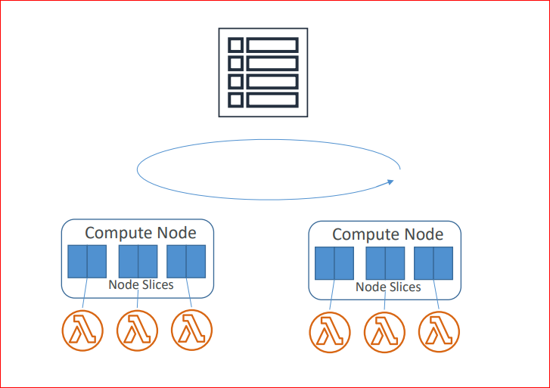
DATA BOOTCAMP 2022/AWS Redshift concepts and Best Practices – Dist key
EVEN distribution

Slide 14
DATA BOOTCAMP 2022/AWS Redshift concepts and Best Practices – Dist key
EVEN distribution
The leader node distributes the rows across the slices in an even round-robin fashion
EVEN distribution is appropriate when a table does not participate in joins or when there is not a clear choice between KEY distribution and ALL distribution.
With no joins involved, this is a good choice, but when joins are involved then the rows matched by different tables involved in the join may not all be on the same node and need to be distributed over the network.
If you join an EVEN and an ALL table together, no redistribution is required because the rows of the ALL table are available everywhere.

Slide 15
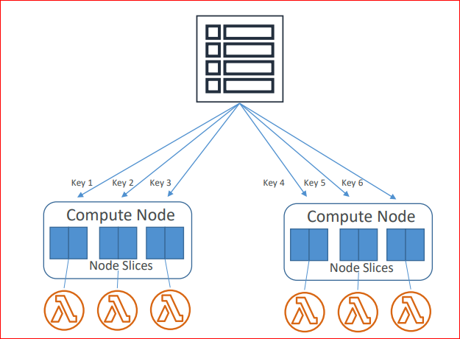
DATA BOOTCAMP 2022/AWS Redshift concepts and Best Practices – Dist key
KEY distribution

Slide 16
DATA BOOTCAMP 2022/AWS Redshift concepts and Best Practices – Dist key
KEY distribution
The rows are distributed according to the values in one column.
The leader node places matching values on the same node slice.
If two tables are distributed on the same column and when you join those two tables on distribution column, then the required data is available in same data slice thus making collocated tables. The collocated tables improve the performance.

Slide 17
DATA BOOTCAMP 2022/AWS Redshift concepts and Best Practices – Dist key
KEY distribution
Consider the following factors when choosing best distribution key:
choose a column with high cardinality: the more distinct the DISTKEY values, the better.
parallel processing is more efficient when you have distributed table rows evenly across the slices.
tables used together should use the common columns for their DISTKEY. For example, in an order system application, use the Customer ID as the DISTKEY for both the customer table and the order table.
if a particular key is used largely in join clauses, then that key is a good choice for the distribution key.

Slide 18
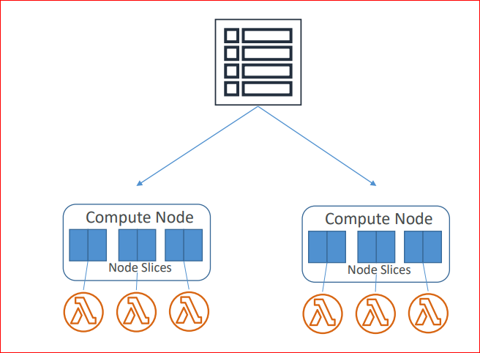
DATA BOOTCAMP 2022/AWS Redshift concepts and Best Practices – Dist key
ALL distribution

Slide 19
DATA BOOTCAMP 2022/AWS Redshift concepts and Best Practices – Dist key
ALL distribution
Make a copy of the table to every node in the cluster.
ALL distribution is appropriate only for relatively slow-moving tables; tables that are not updated frequently or extensively.
The advantages of using ALL (because a copy of the table is maintained on all nodes):
executing a query which includes a join will not copy the required data across the network from node to node, to complete the query
faster query operations
The disadvantages of using ALL (because a copy of the table is maintained on all nodes):
the storage needed for the table is multiplied by the number of nodes
it takes much longer to load, update, or insert data

Slide 20
DATA BOOTCAMP 2022/AWS Redshift concepts and Best Practices – Dist key
Why is the Data Distribution Style so important?
An Amazon Redshift cluster is a set of nodes. Each node in the cluster has its own operating system, dedicated memory, and dedicated disk storage. One node is the leader node, which manages the distribution of data and query processing tasks to the compute nodes.
The disk storage for a compute node is divided into a number of slices. The number of slices per node depends on the node size of the cluster.
When you load data into a table, Amazon Redshift distributes the rows of the table to each of the node slices according to the table's distribution style. As part of a query plan, the optimizer determines where blocks of data need to be located to best execute the query. The data is then physically moved, or redistributed, during execution. Redistribution might involve either sending specific rows to nodes for joining or broadcasting/ copying an entire table to all of the nodes.
Data redistribution can account for a substantial portion of the cost of a query plan, and the network traffic it generates can affect other database operations and slow overall system performance.

Slide 21
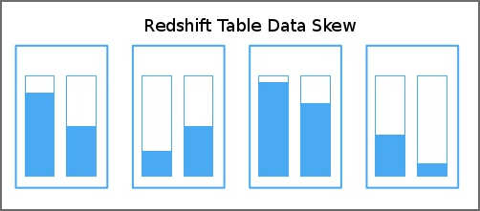
DATA BOOTCAMP 2022/AWS Redshift concepts and Best Practices – Dist key
Why is the Data Distribution Style so important?
Data distribution has two primary goals:
To distribute the workload uniformly among the nodes in the cluster. Uneven distribution, or data distribution skew, forces some nodes to do more work than others, which impairs query performance.
To minimize data movement during query execution. If the rows that participate in joins or aggregates are already collocated on the nodes with their joining rows in other tables, the optimizer does not need to redistribute as much data during query execution.
The distribution strategy that you choose for your database has important consequences for query performance, storage requirements, data loading, and maintenance. By choosing the best distribution style for each table, you can balance your data distribution and significantly improve overall system performance.
Notes:
Useful links related to the distribution style can be found here: https://aws.amazon.com/blogs/big-data/amazon-redshift-engineerings-advanced-table-design-playbook-distribution-styles-and-distribution-keys/
https://docs.aws.amazon.com/redshift/latest/dg/c_choosing_dist_sort.html
https://docs.aws.amazon.com/redshift/latest/dg/viewing-distribution-styles.html
https://docs.aws.amazon.com/redshift/latest/dg/t_Distributing_data.html
https://docs.aws.amazon.com/redshift/latest/dg/t_designating_distribution_styles.html
https://www.matillion.com/blog/redshift/aws-redshift-performance-choosing-the-right-distribution-styles/
https://hevodata.com/blog/redshift-distribution-keys/
http://dwgeek.com/amazon-redshift-distribution-types-examples.html/
http://dwgeek.com/redshift-distributes-table-data-importance-right-distribution-key.html/
https://www.blendo.co/amazon-redshift-guide-data-analyst/data-modeling-table-design/table-distribution-styles/
https://www.matillion.com/blog/redshift/looking-under-the-hood-at-how-amazon-redshift-works/

Slide 22
DATA BOOTCAMP 2022/AWS Redshift concepts and Best Practices – Best practices
Best practices when designing tables
Define sort key when designing a table. Do not compress the sortkey
Avoid creating small table
Use date/time for the date Columns
Define primary key and foreign key but take in consideration that these are only formal for the table, these are not enforced by RS(sample to add)
Use a smallest possible column size
Create views to expose data to users instead of letting them to query directly the source tables
Notes:
Samples for create table can be found here: https://docs.aws.amazon.com/redshift/latest/dg/r_CREATE_TABLE_examples.html

Slide 23
DATA BOOTCAMP 2022/AWS Redshift concepts and Best Practices – Dist key
Maintenance
Analyze, vacuum – these needs to be done for the tables where there are a lots of inserts and deletes
Drop old/unused columns
Managing the volume of merged rows - Amazon Redshift
Analyze - Updates table statistics for use by the query planner. Following the required privileges for this action:
Superuser
Users with the ANALYZE privilege
Owner of the relation
Database owner whom the table is shared to
Notes:
https://docs.aws.amazon.com/redshift/latest/dg/r_ANALYZE.html
Sample analyze table_name;
analyze venue(venueid, venuename); - only some columns

Slide 24
DATA BOOTCAMP 2022/AWS Redshift concepts and Best Practices
Vacuum
A vacuum restores the table's sort order in two stages:
Sort the unsorted region into a newly-sorted region. The first stage is relatively cheap, because only the unsorted region is rewritten. If the range of sort key values of the newly-sorted region is higher than the existing range, only the new rows need to be rewritten, and the vacuum is complete. For example, if the sorted region contains ID values 1 to 500 and subsequent copy operations add key values greater than 500, then only the unsorted region needs to be rewritten.
Merge the newly-sorted region with the previously-sorted region.If the keys in the newly sorted region overlap the keys in the sorted region, then VACUUM needs to merge the rows. Starting at the beginning of the newly-sorted region (at the lowest sort key), the vacuum writes the merged rows from the previously sorted region and the newly sorted region into a new set of blocks.

Slide 25
DATA BOOTCAMP 2022/AWS Redshift concepts and Best Practices
VACUUM command
• Recovers space from deleted rows
• VACUUM FULL - default
• VACUUM DELETE ONLY (based on the number of deleted rows in database tables)
• VACUUM SORT ONLY (Sorts the specified table (or all tables in the current database) without reclaiming space freed by deleted rows)
• VACUUM REINDEX(Analyzes the distribution of the values in interleaved sort key columns)
VACUUM [ FULL | SORT ONLY | DELETE ONLY | REINDEX | RECLUSTER ] [ [ table_name ] [ TO threshold PERCENT ] [ BOOST ] ]
select "table", unsorted,vacuum_sort_benefit from svv_table_info order by 1;

Slide 26
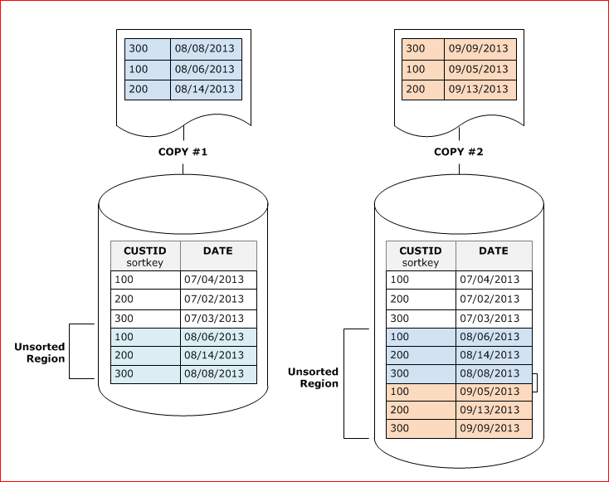
DATA BOOTCAMP 2022/AWS Redshift concepts and Best Practices

Slide 27
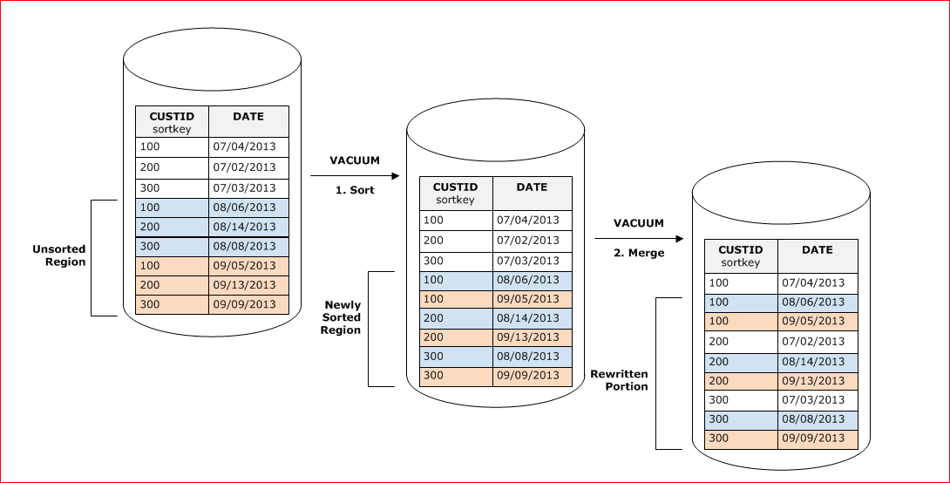
DATA BOOTCAMP 2022/AWS Redshift concepts and Best Practices

Slide 28
DATA BOOTCAMP 2022/AWS Redshift concepts and Best Practices
Redshift Performance
Massively Parallel Processing (MPP)
Columnar Data Storage
Column Compression

Slide 29
DATA BOOTCAMP 2022/AWS Redshift concepts and Best Practices
Create views
Normal views
Materialized views

Slide 30
DATA BOOTCAMP 2022/AWS Redshift concepts and Best Practices
Importing / Exporting data
COPY command
Parallelized;
efficient From S3, EMR, DynamoDB, remote hosts
S3 requires a manifest file and IAM role
UNLOAD command
Unload from a table into files in S3
Enhanced VPC routing

Slide 31
DATA BOOTCAMP 2022/AWS Redshift concepts and Best Practices

